Slide 1
CONGESTIVE HEART FAILURE
Assoc. Prof. Meki Bilici
Pediatric Cardiologist

Slide 3
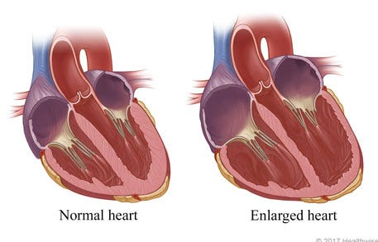
DESCRIPTION
Congestive heart Failure (CHF) is a clinical syndrome in which
Heart is unable to pump enough blood to the body to meet its needs to dispose of systemic or pulmonary venous return adequately or a combination two.

Slide 4
CAUSES
CONGENITAL HEART DISEASE
VOLUME OVERLOAD
VSD, AVSD Most common cause of CHF in 6 months of life
PDA for premature babies
ASD cause for older ages
TAPVD
PRESSURE OVERLOAD
Aort stenosis,
Aortic coarctation,
HLHS,
Critical Pulmonary stenosis

Slide 5
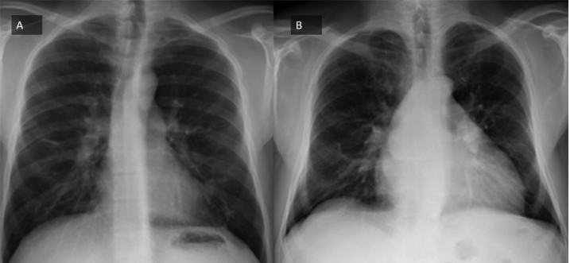

Slide 6
CAUSES
ACQUIRED HEART DISEASES
Metabolic abnormalities
Endocardial fibroelastosis
Viral myocarditis
Acute Rhematic Fever Carditis
Rhematic chronic valvular heart disease
Dilated CMP
Freidreich’s Ataxia
Doxorubicin CMP

Slide 7
Causes
Mıscallenous
SVT
Complete Heart Block
Anemia
Acute Hypertension
BPD in prematures
Cor pulmonale

Slide 8
PATHOPHYSIOLOGY
Cardiac output is determined by preload, afterload, myocardial contractility and heart rate
Increase in preload
İncrease in afterload HEART FAILURE
Decrease Contractility
Increase heart rate

Slide 9
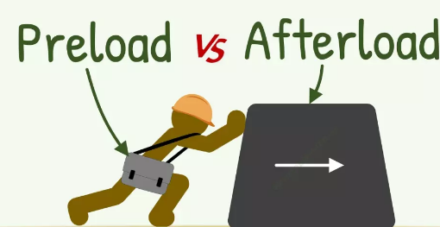

Slide 10
Compansatory mechanisms
Activation of
Symphatetic Nervous system
Increase in symphatetic tone secondary to increased adrenalin secretion of circulating ephinephrine
Increased neural release of norepinephrine
2. Renin-Angiotensin-Aldosteron system
Angiotensin II may cause a trophic response in vascular smooth muscle (with vasoconstriction) and myocardial hypertrophy, attemting to restore wallstress to normal

Slide 11
HISTORY
Poor feding: They get tired quickly during breastfeeding and stop breastfeeding.
Tachypnea worsens during feeding
Poor weight gain
Cold sweat on the forehead
Shortness of breath
Easy fatigability
Puffy eyelids
Swollen feet

Slide 12
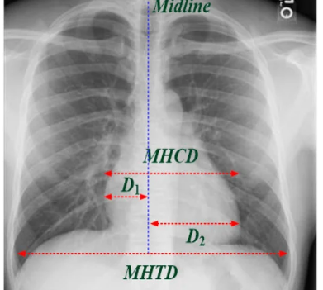
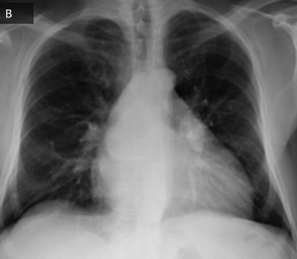

Slide 13
Physical Examination
COMPENSATORY RESPONSES TO IMPAIRED CARDIAC FUNCTIONS
Tachycardia
Gallop rhythm
Weak pulses
Cardiomegaly
Signs of increased symphatetic discharge (cold wet skin, tachycardia, perspiration)

Slide 14
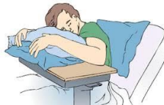
Physical Examination
PULMONARY VENOUS CONGESTION
Tachypnea
Dyspnea on exertion (poor feeding for small infants)
Orthopnea
SYSTEMIC VENOUS CONGESTION
Hepatomegaly
Puffy eyelids
Distended nech veins
Ankle edema

Slide 17
TELECARDIOGRAPHY

Slide 18
Laboratory
CHEST X RAY
Cardiomegaly
ECHOCARDIOGRAPHY
Enlarged heart chambers
Impaired left heart functions
Decreased EF, FS
Increased preejection period/LV ejection time
Cause of CHF
ELECTROCARDIOGRAPHY
Not spesific

Slide 19
CARDIAC BIOMARKERS What exactly is the term biomarker ?
The National Institutes of Health define a biomarker as a “characteristic that is objectively measured and evaluated as an indicator of normal biologic processes, pathogenic processes, or pharmacologic responses to a therapeutic intervention”
These are substances detectable in blood, urine, or other bodily fluids. Tests measuring them should be readily available, be quantitative, reproducible and generally inexpensive

Slide 20
BNP and NT-proBNP
BNP is a hormone produced in response to ventricular overload, and NTproBNP is the fragment produced from the cleavage of proBNP.
BNP and NT-proBNP levels are elevated in patients with HF and correlate with functional and morphological left ventricular parameters and they independently predict prognosis

Slide 21
Galectin-3 and cardiac troponins
Galectin-3, secreted by activated macrophages, causes cardiac fibrosis Increasingly being used as a s surrogate indicator of cardiac remodeling and fibrosis.
Troponin I was detectable (≥0.04 ng /ml) in approx half of 240 patients with advanced, chronic heart failure without ischemia.
Troponin I remained an independent predictor of death.
Troponin T levels > 0.02 ng /ml chronic HF associated with a hazard ratio for death of more than 4

Slide 22
MANAGEMENT
Eliminating of underlying cause
Eliminating presipitating cause (anemia, infection etc)
Control of the heart failure

Slide 23
GENERAL MEASURES
Cardiac chair or infant seat is used to relief respiratory distress
Oxygen
Sedation with morphine sulfat
Salt restriction
Daily weight measurement
Eliminate the predisposing factors (anemia, fever, infection etc)
Underlying causes such as hypertension, arrhytmias, thyrotoxicosis

Slide 24
DRUG THERAPY
Inotropic agents
Diuretics
Afterload reducing agents

Slide 25
Diuretics
Diuretics remain the principal therapeutic agent to control pulmonary and systemic venous congestion
Diuretics reduce preload and improves congestive symptoms, but do not improve cardiac output or myocardial contractility
Loop diuretics commonly used
Aldosterone antagonists- used in conjunction with a loop diuretic

Slide 26
DIURETICS
PREPARATION | ROUTE | DOSAGE
THIAZİDE
Chlorthiazide | Oral | 20-40mg/kg/d
Hydrochlortiazide | Oral | 2-4mg/kg/d
LOOP dıuretıcs
Furosemide | IV and oral | 1mg/kg/dose (2-3 mg/kg/d oral)
Ethacrynic acid | IV and oral | 1mg/kg/dose (2-3 mg/kg/d oral)
Aldosterone Antagonist
Spironolactone | Oral | 1-3mg/kg/d

Slide 27
Diuretics side effects
Hyppokalemia
Hypochloremic alkalosis
Hyponatremia

Slide 28
RAPID ACTING INOTROPIC AGENTS
PREPARATION | DOSAGE AND ROUTE | SIDE EFFECTS
EPINEPHRINE | 0.1-1 mcg/kg/min IV | Hypertension
ISOPROTERENOL | 0.1-0.5 mcg/kg/min IV | Peripheral,pulmonary vasodilatation
DOPAMİNE | 5-10 mcg/kg/min IV | dose related CV effects
DOBUTAMIN | 2-8 mcg/kg/min IV
MILRINONE | 0.5-2 mcg/kg/min IV

Slide 29
DIGITALIS GLIKOSIDES and dosage
Digoxin is the most commonly used preparation
AGE | TOTAL DOSE (mcg/kg) | MAINTENANCE DOSE (mcg/kg/day) divided in two doses
PREMATURES | 20 | 5
NEWBORNS | 30 | 8
Under 2 years | 40-50 | 10-12
Above 2 years | 30-40 | 8-10
16

Slide 30
HOW to DIGITALIZE
Loading dose of total dose are given over 12 to 18 hours
Than maintenance dose is started
In small infants maintenance dose is given without loading
Obtaine a basal ECG for basal PR, rhtyim and PR interval
Calculate the total digitalis dose (by two different persons)
Give one half of the total digitalis dose immediately followed by one fourth and final one fourth dose is given 6 hours intervals
Start the maintenace dose after 12 hours later
17

Slide 31
Digitalis TOXICITY
Noncardiac symptoms
anorexia,nausea,vomiting,diarhea,drowsiness,fatigue,visual disturbances
Heart failure worsens
ECG signs
prolongation of PR interval
Supraventricular arrhytmias
Ventricular arrhytmias
Elevated level of serum digoxin (>2ng/ml)
18

Slide 32
TREATMENT of DIGITALIS TOXICITY
Discontinuation of digoxin and diuretics
Treating the predisposing factors
myocardial ischemia
myocarditis
hypokalemia, hypercalcemia, hypomagnesemia
hypoxia
alkalosis
adrenergic stimuli and cathecolamines
amiadarone,cinidine
thyroid dysfunctions
Treating the cardiac arrhytmias
19

Slide 33
Phosphodiesterase III inhibutors (Amrinon, Milrinon, Enoksimon, Vesnarinon)
Intracellular cAMP levels are increased
(+) inotropic effect
Do not increase the heart rate
Very low incidence for dysrhtimia
c AMP related vasodilatation on systemic and pulmonary arterial bed
Beta adrenergic agonists are potentilized these effects
In Cardiovascular ıntensive Care Unit added to dopamine
21

Slide 34
AFTERLOAD REDUCING AGENTS
DRUG | TOTAL DOSE (mcg/kg) | COMMENTS
CAPTOPRİL | 0.1-0.4 mg/kg/dose (2 times a day) | hypotension,dyssiness,neutropenia, proteinuria
ENALAPRİL | 0.1 mg/kg/dose (once a day) | hypotension,dyssiness, syncope
NITROPRUSSIDE | 0.5-8mcg/kg/min | 10-12
PROZOSIN | 5 mcg/kg up to 50-100 mcg/kg/day | ortostathic hypotension
22

Slide 35
CARNITINE
Carnitine, which is an essential cofactor for transport of long-chain fatty acid into mitochondria for oxidation, has been shown to be beneficial in some cases of cardiomyopathy Most of these patients had dilated cardiomyopathy
DOSE- 50 to 100 mg/kg/day, given twice a day or three times a day orally (maximum daily dose, 3 g)
It improved myocardial function, reduced cardiomegaly, and improved muscle weakness. Ventricular arrhytmias
18

Slide 36
NON FARMACOLOGICAL TREATMENTS
ECMO
Ventricular Assist Devices
Intraaortic balloon pump
Total artifical heart
Heart Transplantation
23

Slide 37
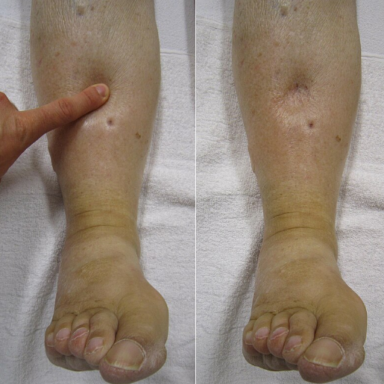
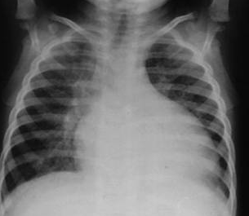
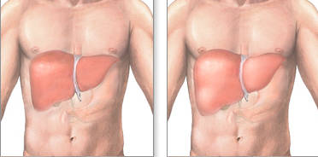
DON’T FORGET

Slide 38
THANK YOU

